Slide 1
Welcome to Communications
Mr. Brown

Slide 2
What is Communications all about?
This class will help guide you through different communication strategies.
*Public speaking is the main
component of this class.

Slide 3
We will focus on:
Interpersonal Communication
Interpretive Communication
Presentational Communication

Slide 5
Class
* 67 minutes
* One semester course
(B days)

Slide 6
Supplies
* Fully charged chromebook in class
* Earbuds

Slide 7
Grading
* This is a project based class
* No quizzes/tests
* Homework will only be necessary if behind in class

Slide 8
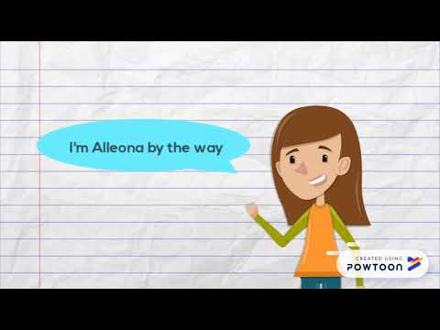

Slide 11
I look forward to a wonderful year ☺
WBrown@jacksonsd.org

